Slide 1
EU Sustainable Finance and Investment
Dr Linh Nguyen

Slide 2
Course Outline
Introduction to Sustainable Finance
The EU’s Approach to Sustainable Finance
Sustainable Finance Instruments and Products
Case Studies in EU Sustainable Finance
Challenges and Opportunities in EU Sustainable Finance

Slide 3
Part 1: Introduction to Sustainable Finance

Slide 4
Agenda
What is Sustainable Finance?
Why is Sustainable Finance Important?
Benefits of Sustainable Finance
What is Transition Finance

Slide 5
What is sustainable finance?

Slide 6
What is Sustainable Finance?
The process of taking environmental, social and governance (ESG) considerations into account when making investment decisions in the financial sector, leading to more long-term investments in sustainable economic activities and projects.

Slide 7
What is Sustainable Finance?
Environmental Considerations:
Addressing climate change through mitigation and adaptation efforts.
Other environmental aspects involve preserving biodiversity, preventing pollution, and promoting circular economy practices.
Social Considerations:
Issues of inequality, inclusiveness, labor relations, and investment in people and communities.
Human rights issues and skills development.
Governance Aspects:
The governance of public and private institutions plays a crucial role.
These include management structures, employee relations, and executive remuneration.

Slide 8
What is Sustainable Finance?
EU’s Perspective:
Sustainable finance supports economic growth while minimizing environmental impact. It aligns with the European Green Deal’s climate- and environmental objectives.
Sustainable finance also encompasses transparency when it comes to risks related to ESG factors that may have an impact on the financial system, and the mitigation of such risks through the appropriate governance of financial and corporate actors.

Slide 9
Examples – Green Bonds
Debt instruments issued to fund environmentally friendly projects, such as renewable energy infrastructure or clean water initiatives.

Slide 10
Other examples
Impact Investing: Investors intentionally allocate capital to projects or companies that generate positive social or environmental impact alongside financial returns.
Microfinance: Providing financial services to underserved communities, supporting small businesses, and promoting economic inclusion.
Active Ownership: Investors engage with companies to influence their behavior, advocating for sustainable practices and better governance.

Slide 11
Other Examples
Sustainable Funds: These investment funds specifically focus on companies with strong ESG performance.
Renewable Energy Equity Financing: Investing in companies involved in solar, wind, or other renewable energy sources.
Carbon Credits: Trading carbon credits helps offset emissions by supporting projects that reduce greenhouse gases.

Slide 12
Why is Sustainable Finance Important?
Policy Objectives and Global Commitments
European Green Deal
Aims to make Europe the world’s first climate-neutral continent by 2050.
Sustainable finance supports this ambitious goal.
EU’s International Commitments
The EU aligns with global climate and sustainability objectives.
Sustainable finance contributes to meeting these commitments.

Slide 13
Why is Sustainable Finance Important?
Building a Resilient Economy
Climate Transition:
Private investment drives the transition to a climate-neutral economy.
Supports renewable energy, clean technology, and carbon reduction.
Resource Efficiency:
Sustainable finance encourages efficient resource use.
Reduces waste, promotes circular economy practices.
COVID-19 Recovery:
Investments in sustainable projects aid economic recovery.
Creates jobs, strengthens communities.

Slide 14
Transition Finance

Slide 15
Transition Finance
To bridge the gap between what is already environment-friendly today (green finance) and what is transitioning to environment-friendly performance levels over time (transition finance).
To finance private investments that reduce greenhouse gas emissions and other environmental impacts, transition to a climate neutral and sustainable economy
Examples: Investments in green production methods, emission reduction, and sustainable practices.

Slide 16
Why is Transition Finance needed?
Climate Goals:
Aims to reduce greenhouse gas emissions by 55% by 2030.
Transition finance accelerates this critical reduction.
Step-by-Step Approach:
Companies with varying sustainability starting points benefit.
Allows gradual progress toward a sustainable future.

Slide 17
Supporting Companies in Transition Finance
Recommendations:
EU issued non-binding guidelines for transition finance.
Both financial and non-financial companies can use sustainable finance tools.
Inclusivity:
Supports companies with different sustainability records.
Allows smaller firms to raise proportionate finance for their transition.

Slide 18
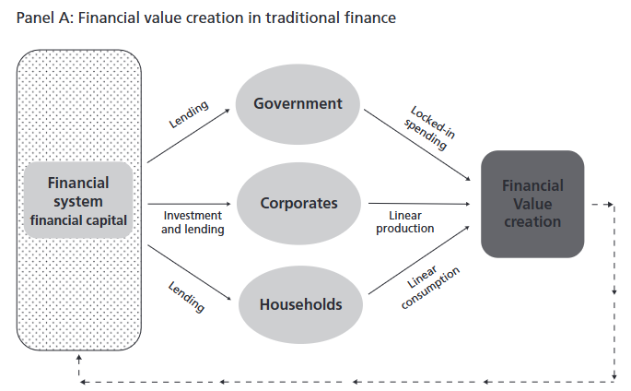
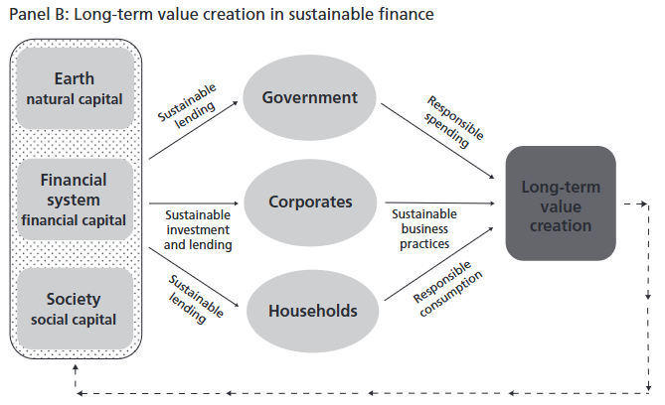
Value creation: From an old to a new version

