Slide 1
EU Sustainable Finance and Investment
Dr Linh Nguyen

Slide 2
Course Outline
Introduction to Sustainable Finance
The EU’s Approach to Sustainable Finance
Sustainable Finance Instruments and Products
Case Studies in EU Sustainable Finance
Challenges and Opportunities in EU Sustainable Finance

Slide 3
Part 3: Sustainable Finance Instruments and Products

Slide 4
Agenda
The EU sustainable finance framework
Policy making timeline
The European Green Deal
EU Action Plan on Sustainable Finance

Slide 5
Key Components of the EU Sustainable Finance Framework
EU Taxonomy Regulation
Sustainable Finance Disclosure Regulation (SFDR)
Corporate Sustainability Reporting Directive (CSRD)
Green Bond Standard
EU Action Plan on Sustainable Finance
Investment Strategies and Guidelines
Support for Sustainable Economic Activities
Strategic Goals
Climate Neutrality: Achieving net-zero greenhouse gas emissions by 2050.
Biodiversity: Protecting and enhancing the natural environment.
Social Responsibility: Ensuring social inclusion and equity in sustainable development.

Slide 6
Policy making timeline
2015
Adoption of the Paris Agreement, influencing EU climate policies.
2018
The European Commission publishes the Action Plan on Sustainable Finance.
2019
Introduction of the EU taxonomy for sustainable activities, providing a classification system for sustainable investments.
2020
Implementation of the Sustainable Finance Disclosure Regulation (SFDR), enhancing transparency in sustainability-related disclosures by financial institutions.
2021
Introduction of the Corporate Sustainability Reporting Directive (CSRD) to improve reporting standards.

Slide 7
Detailed information on the sustainable finance policy-making timeline
European Commission - Sustainable Finance:
Sustainable Finance
European Commission - The European Green Deal:
European Green Deal
European Environment Agency:
European Environment Agency
EU Taxonomy for Sustainable Activities:
EU Taxonomy

Slide 8
Policy making timeline: Overview of sustainable finance - European Commission (europa.eu)

Slide 9
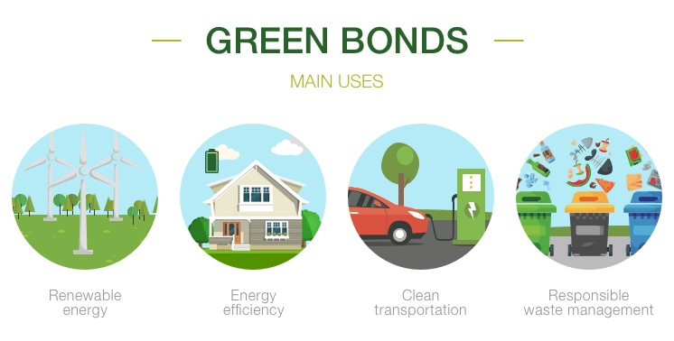
Green Bonds
The European Green Deal is a comprehensive policy initiative aimed at making Europe the first climate-neutral continent by 2050.
Key Components:
Reduction of greenhouse gas emissions.
Promotion of clean energy and energy efficiency.
Sustainable industry and circular economy.
Biodiversity preservation.
Sustainable agriculture and food systems.
Relation to Finance: The Green Deal outlines the need for significant investments in sustainable projects, facilitating the mobilization of private capital through sustainable finance instruments.

Slide 10
Impact Investments
Definition: Impact investing is defined as the deployment of funds into investments that generate a measurable and beneficial social or environmental impact alongside a financial return on investment. An innovative way of boosting the private sector’s contribution to sustainable development can be achieved with impact investing.Key Characteristics: Measuring impact, intentionality
Examples: Social enterprises, funds targeting specific SDGs

Slide 11
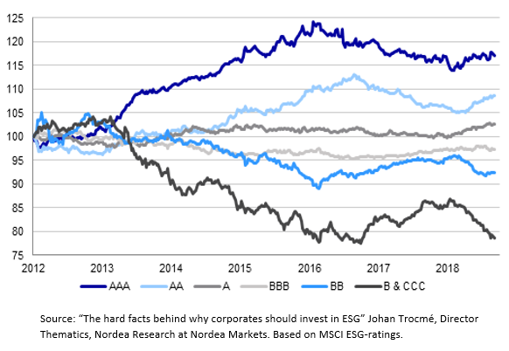
Sustainable Funds
Definition: investment vehicles that prioritize environmental, social, and governance (ESG) factors alongside financial performance
Types: Equity funds, fixed-income funds
Examples: ESG funds, ethical investment funds

Slide 12
Opportunities in Sustainable Finance
Growing demand for sustainable investments
Potential for innovation and new market development
Regulatory support and incentives

Slide 13
Risks Associated with Sustainable Finance
Market risks: volatility and performance uncertainty
01
Regulatory risks: changing compliance requirements
02
Reputational risks: greenwashing concerns
03

Slide 14
Role of Sustainable Finance in Capital Markets
Sustainable finance plays a crucial role in capital markets by aligning investment practices with environmental, social, and governance (ESG) criteria. This shift is transforming how capital is allocated and fostering sustainable economic growth.
Integration into traditional financial systems
Impact on investment strategies
Contributions to long-term economic stability

Slide 15
Part 4: Case Studies in EU Sustainable Finance

Slide 16
Overview of Successful and Innovative Initiatives
The EU has spearheaded various innovative sustainable finance initiatives aimed at driving investments towards sustainable projects. These initiatives serve as exemplars of how sustainable finance can be integrated into capital markets and promote environmental and social goals.
For example:
Initiative | Overview | Impact
Climate Bonds Initiative | Global effort to promote investment in low-carbon and climate-resilient projects. | Establishes standards for climate bonds, ensuring transparency and credibility.
EU Taxonomy Regulation | Classification system defining environmentally sustainable activities. | Guides investors in identifying sustainable projects, driving capital towards green investments.
European Investment Bank (EIB) Climate Bank Roadmap | Commitment to align financing with the Paris Agreement. | Aims to increase financing for climate action projects to over 50% of operations by 2025.

Slide 17
The EU Sustainable Finance Taxonomy: A case study
Ambitious Environmental Targets:
The EU aims to be the first climate-neutral continent by 2050.
Plans to reduce greenhouse gas emissions by at least 55% by 2030 compared to 1990 levels.
Goals include strengthening resilience to climate change, reversing biodiversity loss, and promoting a circular economy.
Investment Requirements:
The EU needs approximately €350 billion in additional annual investment over the current decade to meet its 2030 emissions target for energy systems.
An extra €130 billion per year is required for other environmental goals.
From 2020 to 2050, compliance with the Paris Agreement could necessitate €11.7 billion to €16.3 billion in additional public investments annually (excluding transport).

Slide 18
Analysis of the Impact and Effectiveness of EU Sustainable Finance Initiatives
Increased Investment:
Significant growth in green bond issuance supports renewable energy projects.
Enhanced Transparency:
Regulations like the SFDR improve ESG reporting, leading to greater accountability among companies.
Market Transformation:
The EU Taxonomy reshapes investment strategies, encouraging alignment with sustainability criteria.
Social and Environmental Benefits:
Programs like InvestEU generate job creation and foster advancements in sustainable technologies.

Slide 19
Part 5: Challenges and Opportunities in EU Sustainable Finance

Slide 20
Challenges Facing EU Sustainable Finance
1. Regulatory Barriers:
Complexity and fragmentation of regulations can hinder the implementation of sustainable finance initiatives.
Diverging national rules may create uncertainty, affecting cross-border investments.
2. Data and Disclosure Issues:
Lack of standardized ESG data makes it difficult for investors to assess sustainability performance effectively.
Inconsistent disclosure practices among companies can lead to information asymmetry.
3. Market Liquidity:
Limited market liquidity for sustainable finance products can deter investors.
Smaller issuers may struggle to attract sufficient investment, impacting overall market growth.

Slide 21
Challenges Facing EU Sustainable Finance
Read more: Sustainability challenges | European Environment Agency's home page (europa.eu)
European Green Deal
Objective: Aims for climate neutrality in the EU by 2050.
Components: A comprehensive package covering climate, environment, energy, transport, industry, agriculture, and sustainable finance.
Approach: Advocates for a holistic, cross-sectoral strategy where all policy areas contribute to climate goals.
Support: Implemented through the EU's 8th Environmental Action Programme, linking various initiatives for a sustainable transition.
2030 Agenda for Sustainable Development
Adoption: Launched on September 25, 2015, by UN leaders; includes 17 Sustainable Development Goals (SDGs) and 169 targets.
Goal: Committed to eradicating poverty and achieving sustainable development globally by 2030.
EU's Role: Actively involved in implementing the Agenda and SDGs within the EU and in development cooperation with partner countries, aligning with its sustainable development priorities.

Slide 22
Opportunities for Advancing Sustainable Finance
Technological Innovations:
Fintech solutions can enhance data collection and analysis, improving ESG reporting and transparency.
Blockchain technology offers potential for better tracking of sustainable investments and transactions.
Market Developments:
Growing demand for sustainable investment products from both retail and institutional investors creates opportunities for new offerings.
Increased collaboration among stakeholders can drive innovation in financial products and solutions.
Integration of Sustainability into Mainstream Finance:
As ESG considerations become more mainstream, traditional financial institutions are beginning to integrate sustainable practices, expanding the market reach.
Public-Private Partnerships:
Collaborations between government bodies and private investors can lead to innovative financing solutions for sustainable projects.

